Slide 1






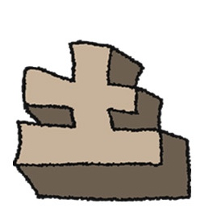
Sunday
Monday
Tuesday
Wednesday
Thursday
Friday
Saturday
weekdays
Sunday
Monday
Tuesday
Wednesday
Thursday
Friday
Saturday
holidays

