Slide 1
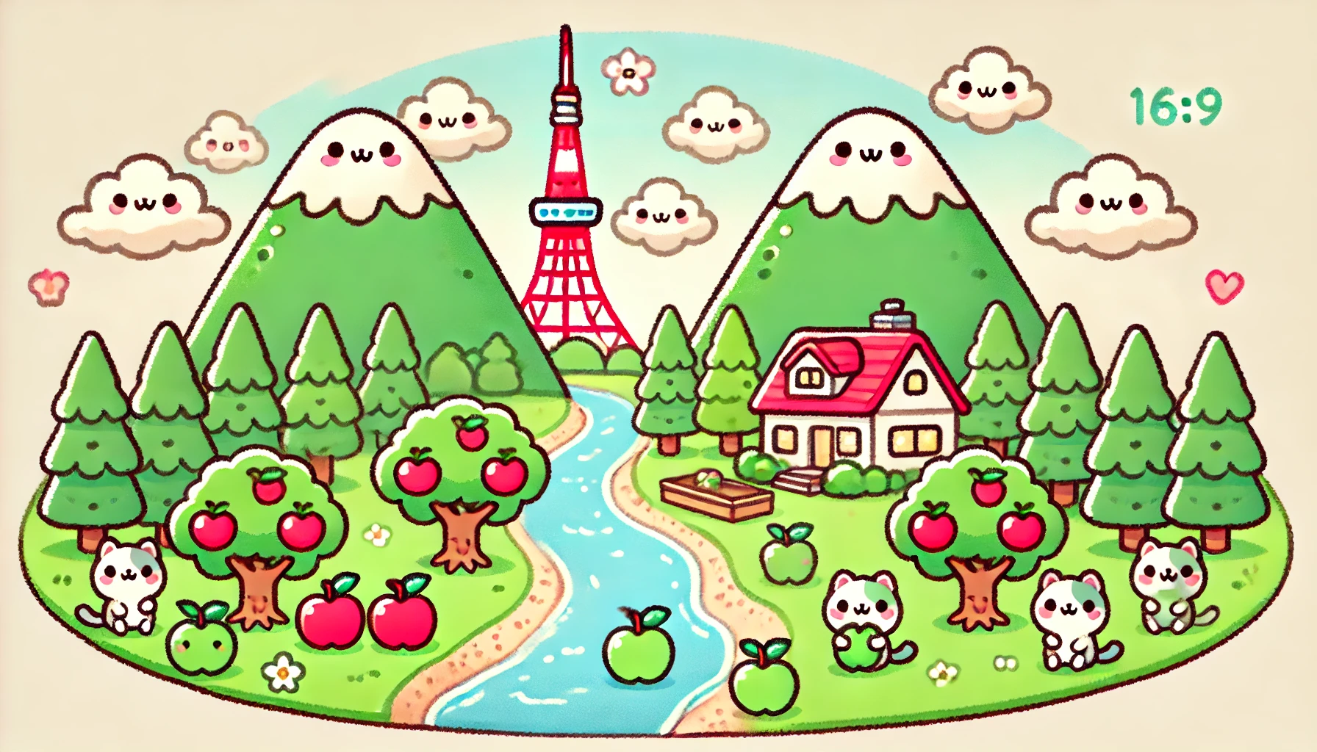
there is / are ~
class
no
name
( ) ( ) two mountains.
( ) ( ) a river between the two mountains.
There is / are 〜の後に
固有名詞は置くことができないんだよ。
( ) ( ) three apple trees by the river.
( ) ( ) is apple in the river.
( ) ( ) ( ) big house on the right side of the river.
( ) ( ) ( ) cats on the right side of the river.
( ) ( ) ( ) cat on the left side of the river.
( ) ( ) eight clouds in the sky. Tokyo Tower ( ) ( ) the two mountains.

