Slide 1
Karuta

Slide 2
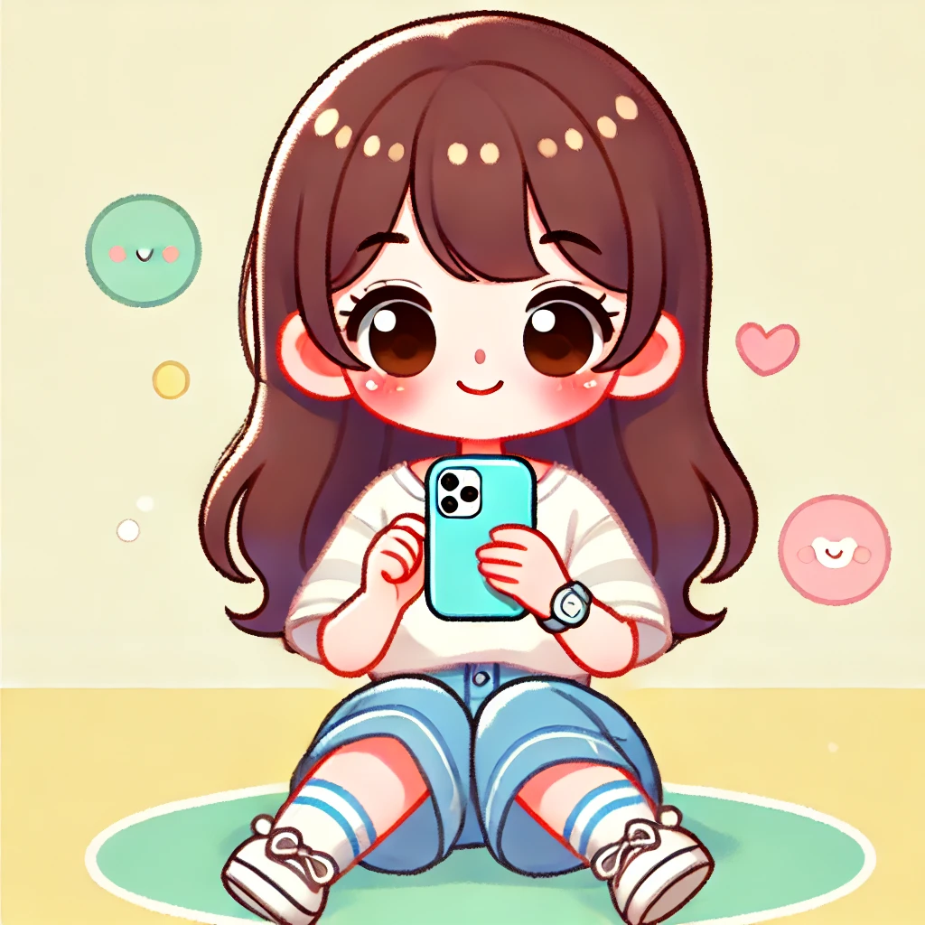
Notes:
This is a girl using a smartphone.

Slide 3
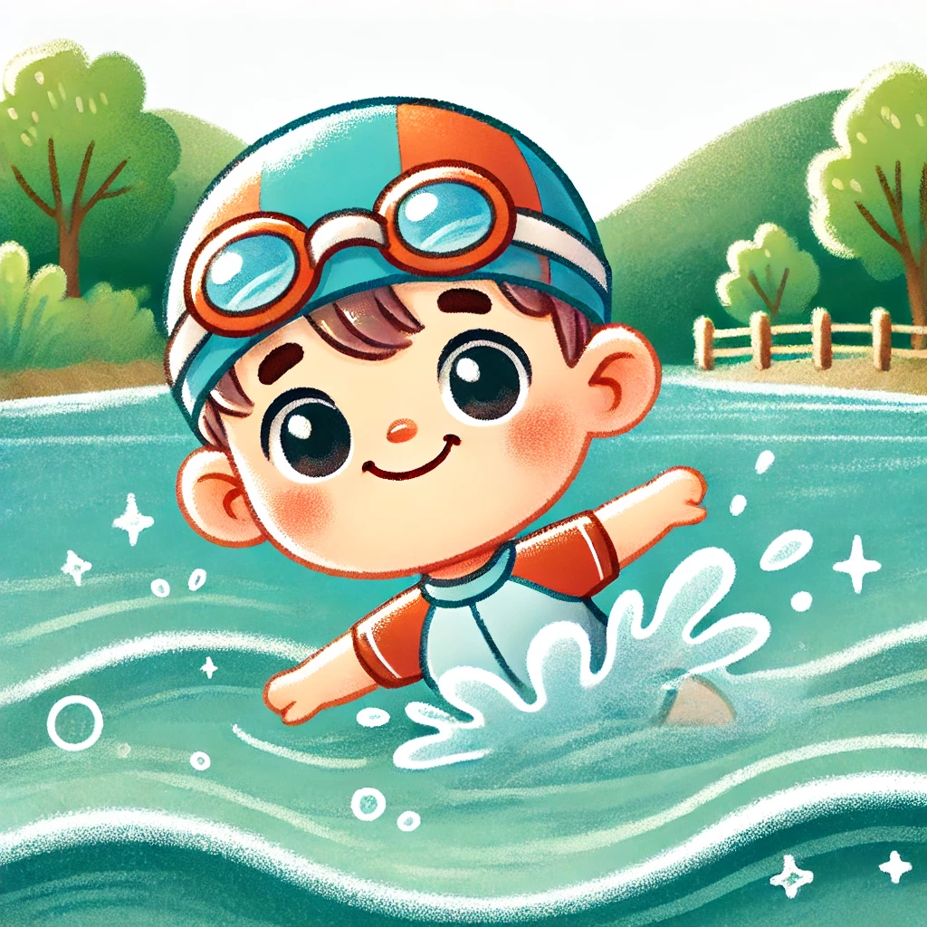
Notes:
This is a boy swimming in the river.

Slide 4

Notes:
This is a boy playing soccer.

Slide 5
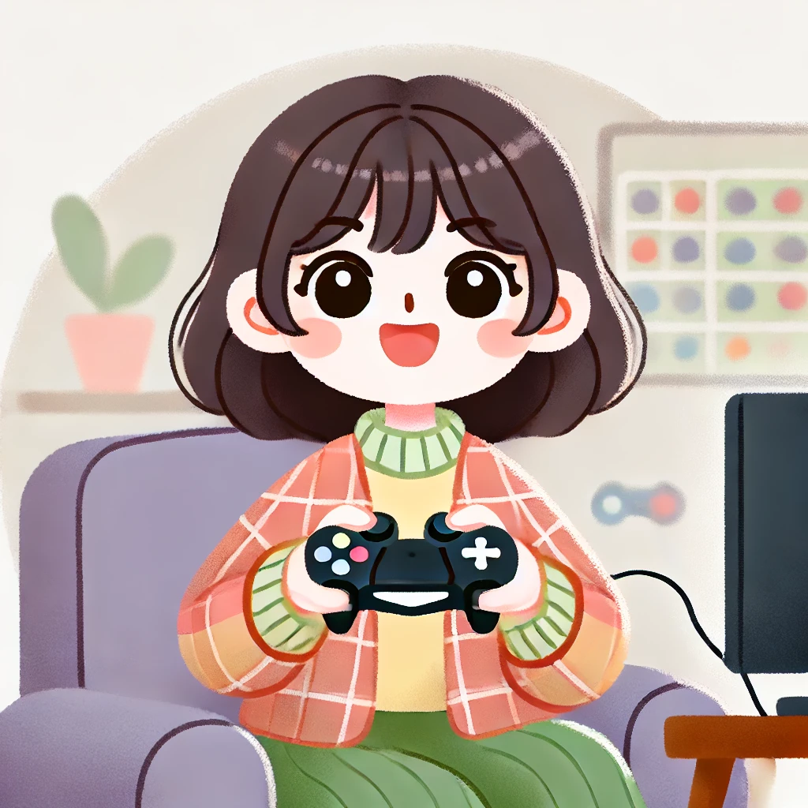
Notes:
This is a girl playing video game.

Slide 6

Notes:
This is a boy using a sign language.

Slide 7
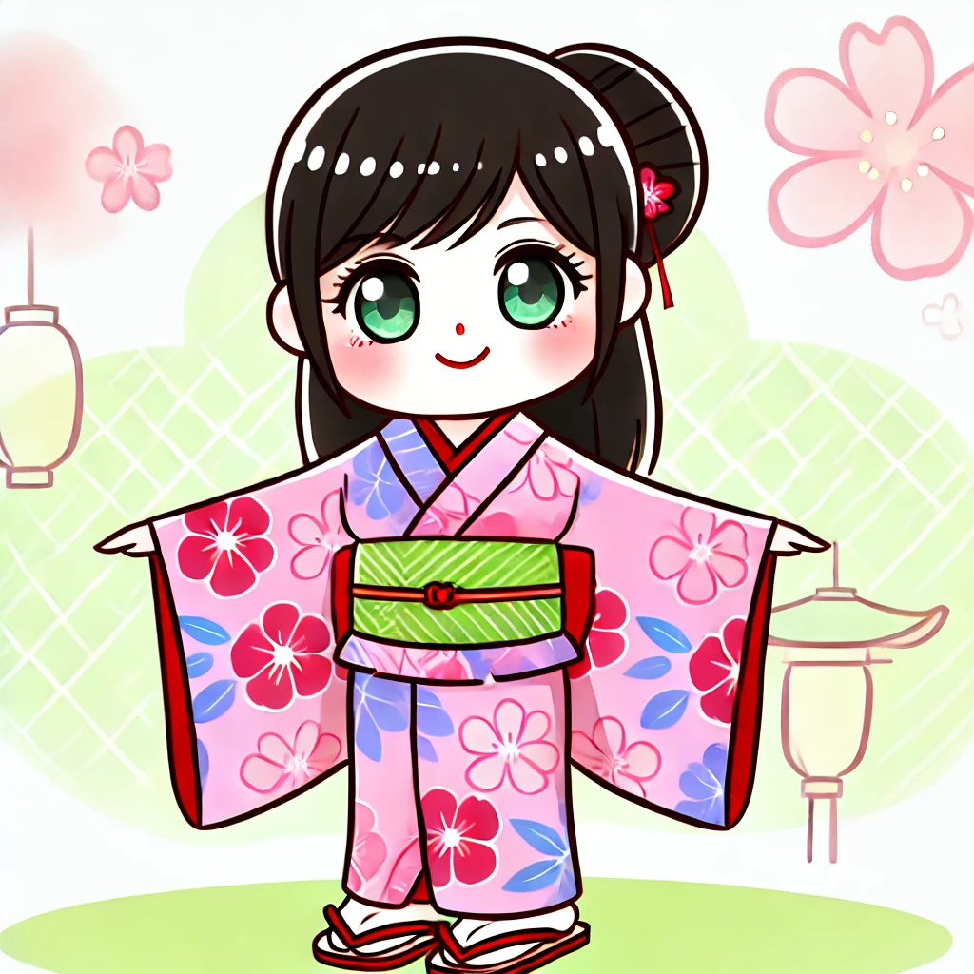
Notes:
This is the girl wearing yukata.

Slide 8
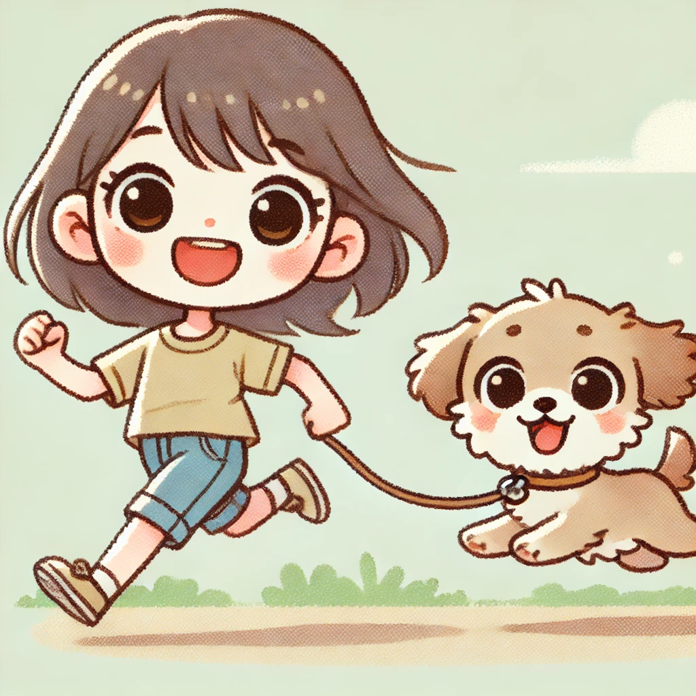
Notes:
This is a girl running with her dog.

Slide 9

Notes:
This is a boy swimming in the sea.

Slide 10

Notes:
This is the girl reading a book under the tree.

Slide 11
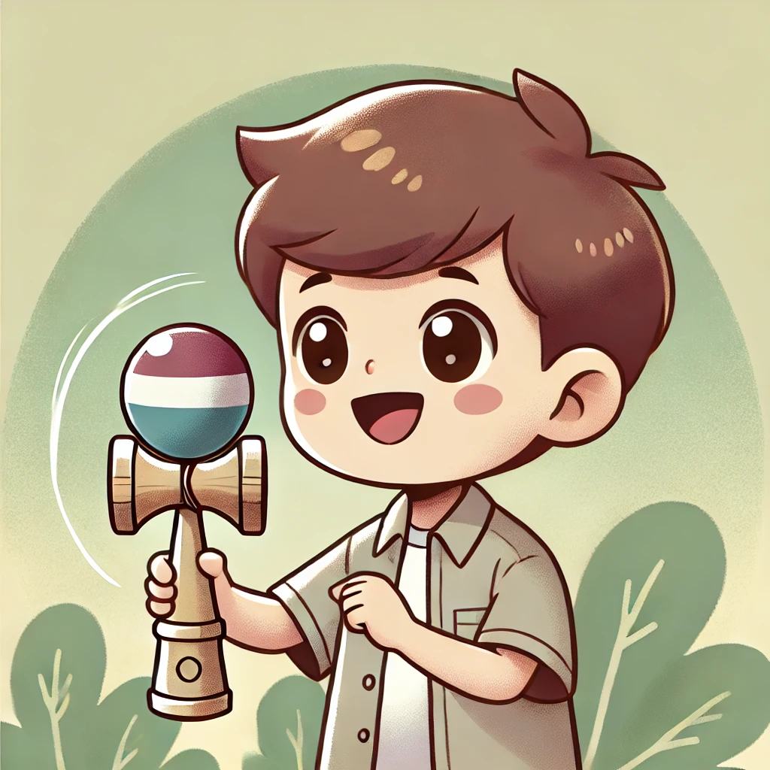
Notes:
This is a boy playing kendama.

Slide 12

Notes:
This is the girl running with her friends.

Slide 13

Notes:
This is a boy wearing glasses.

Slide 14

Notes:
This is the boy making a snow man.

Slide 16
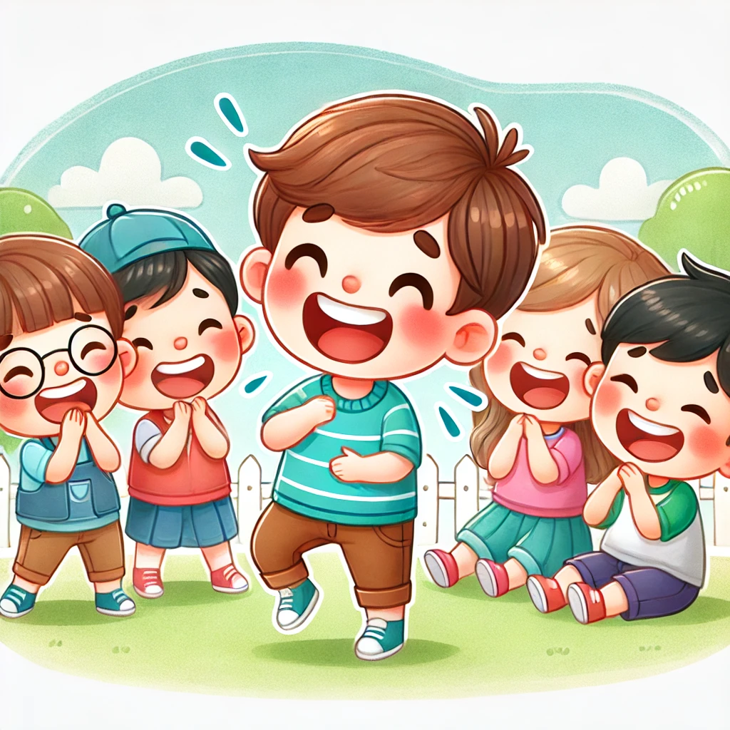
Notes:
This is the boy making friends laugh.

Slide 17

Notes:
This is a girl reading newspapers.

Slide 18
Grammer

Slide 19
This is the boy.

Slide 20
This is the boy swimming in the river.

Slide 21
Practice & Activity

