Slide 1
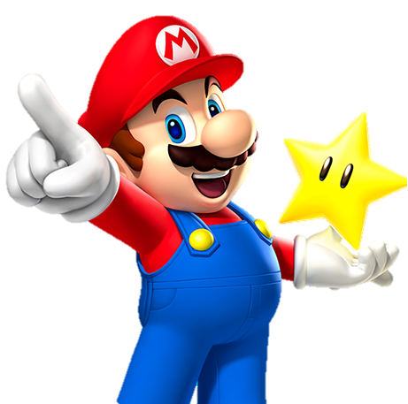

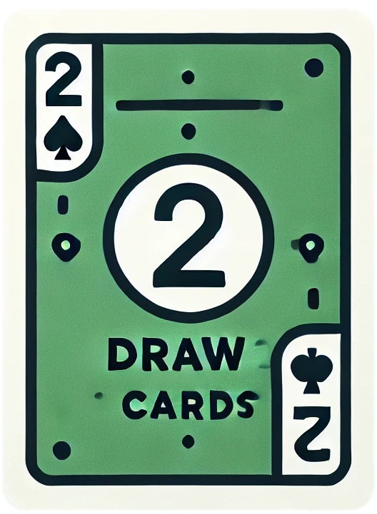

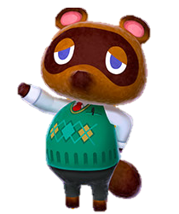


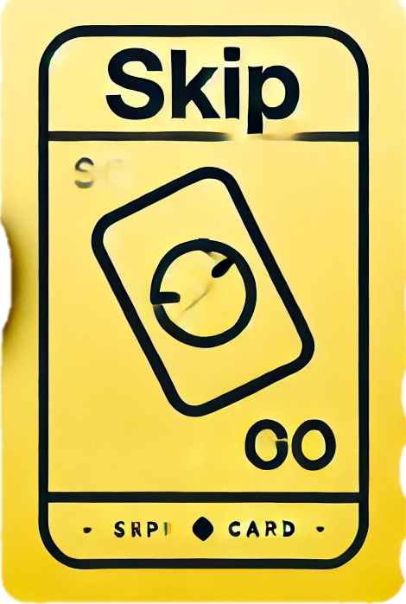

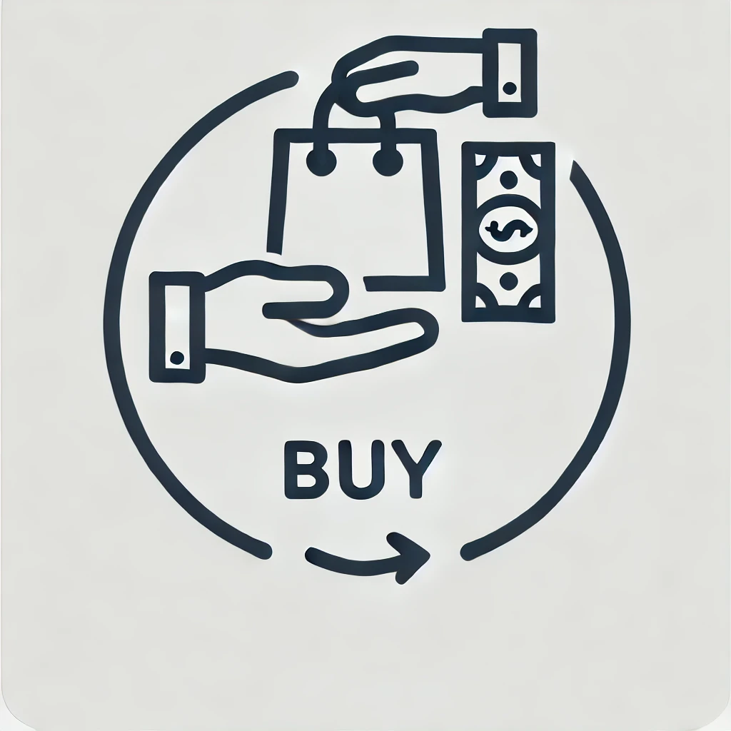
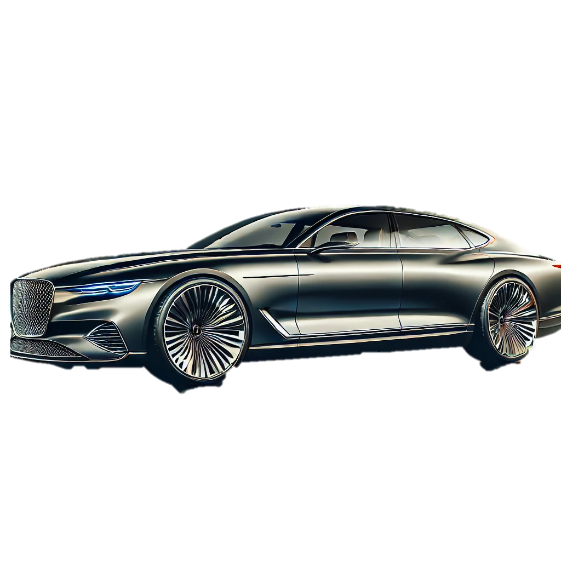

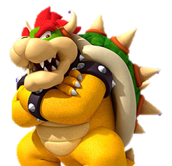

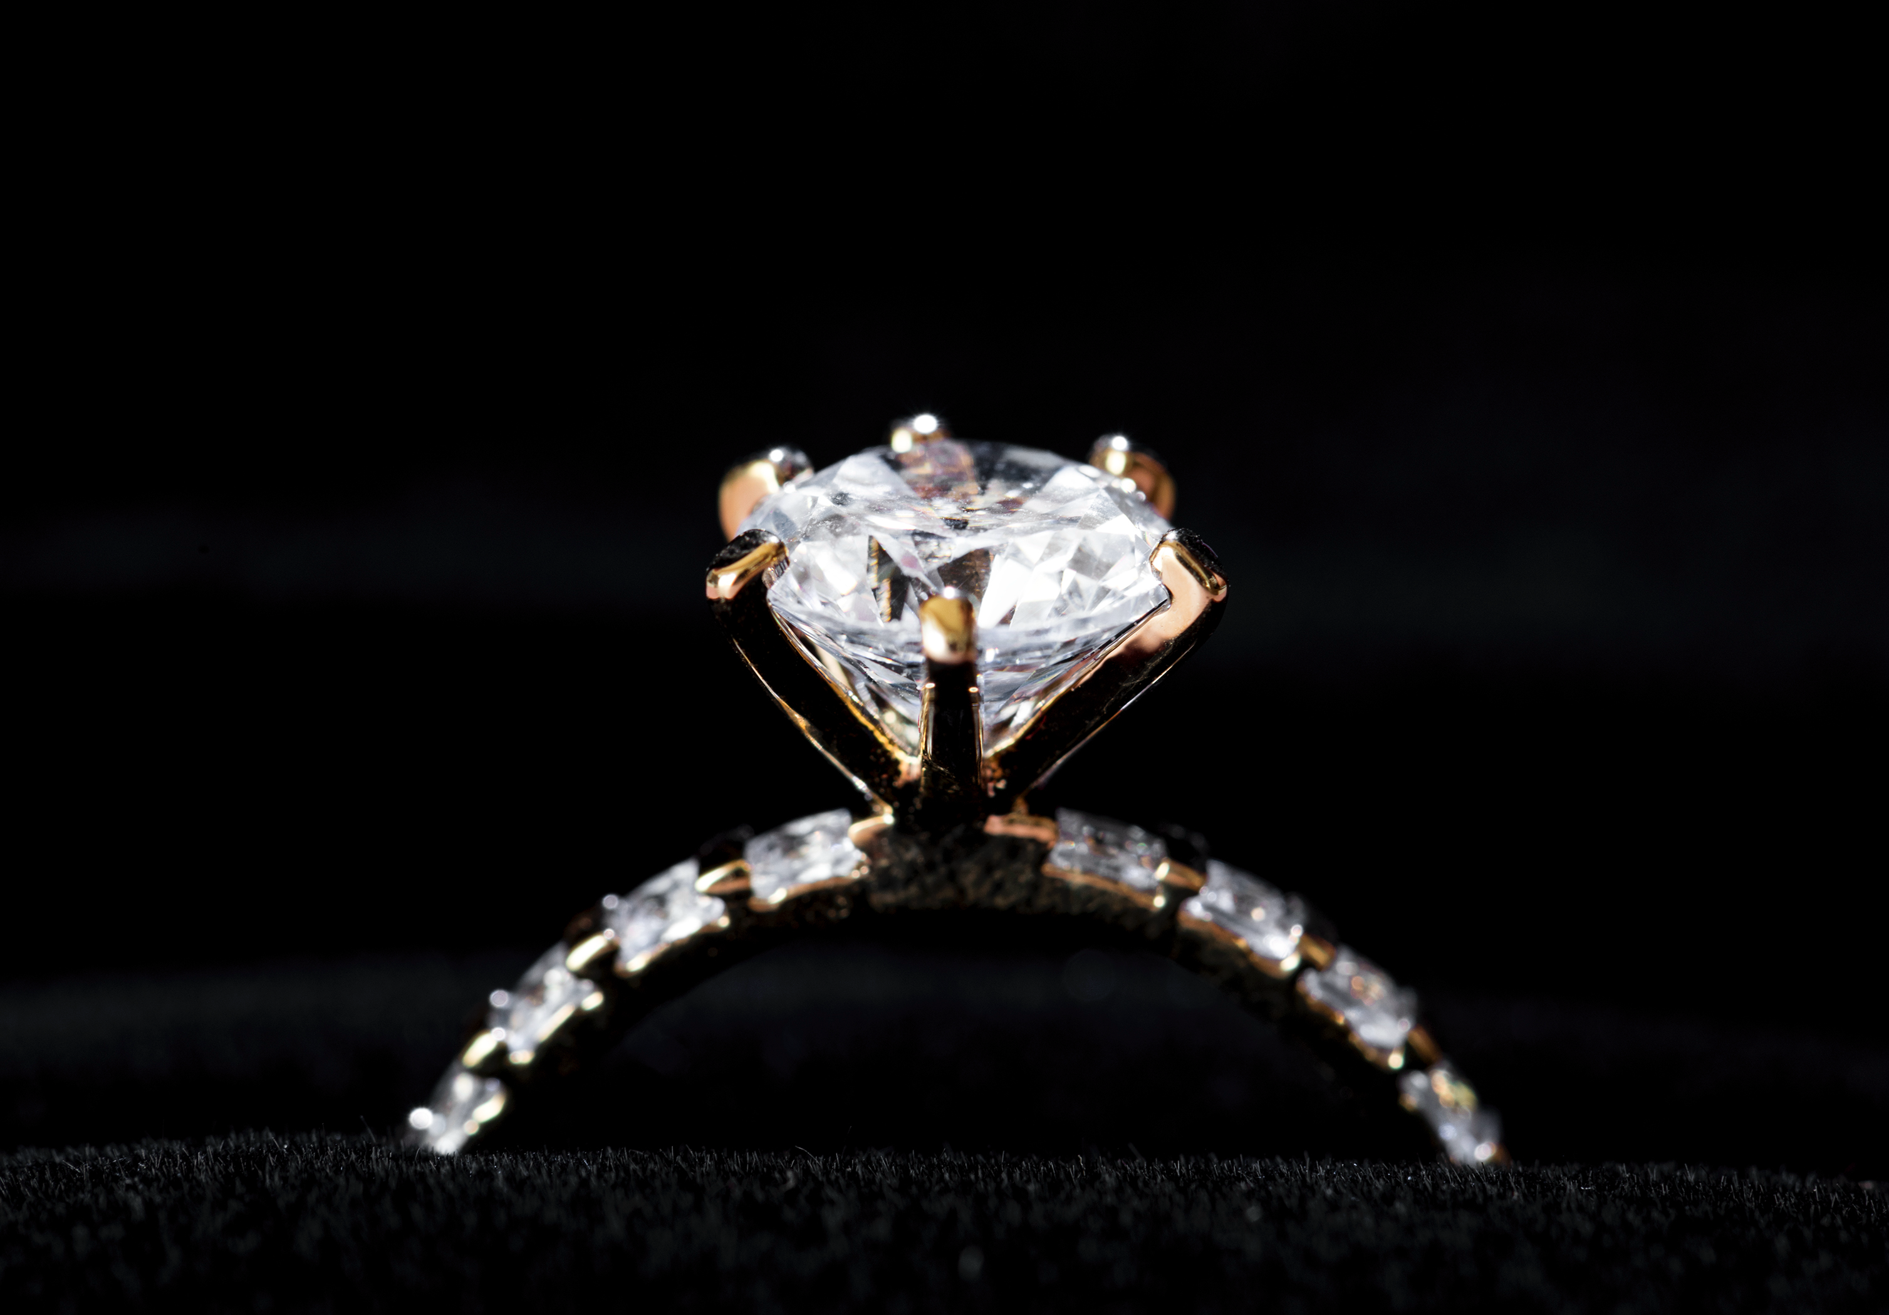
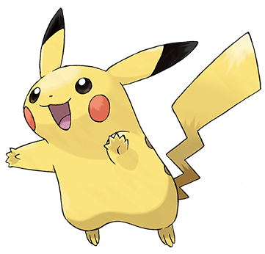


Mario
gave
Mario
a star
Tanukichi
showed
Tanukichi
a shovel
Kirby
bought
Kirby
a car
Koopa
sent
Koopa
a ring
Pikachu
made
Pikachu
a lot of books

Slide 2


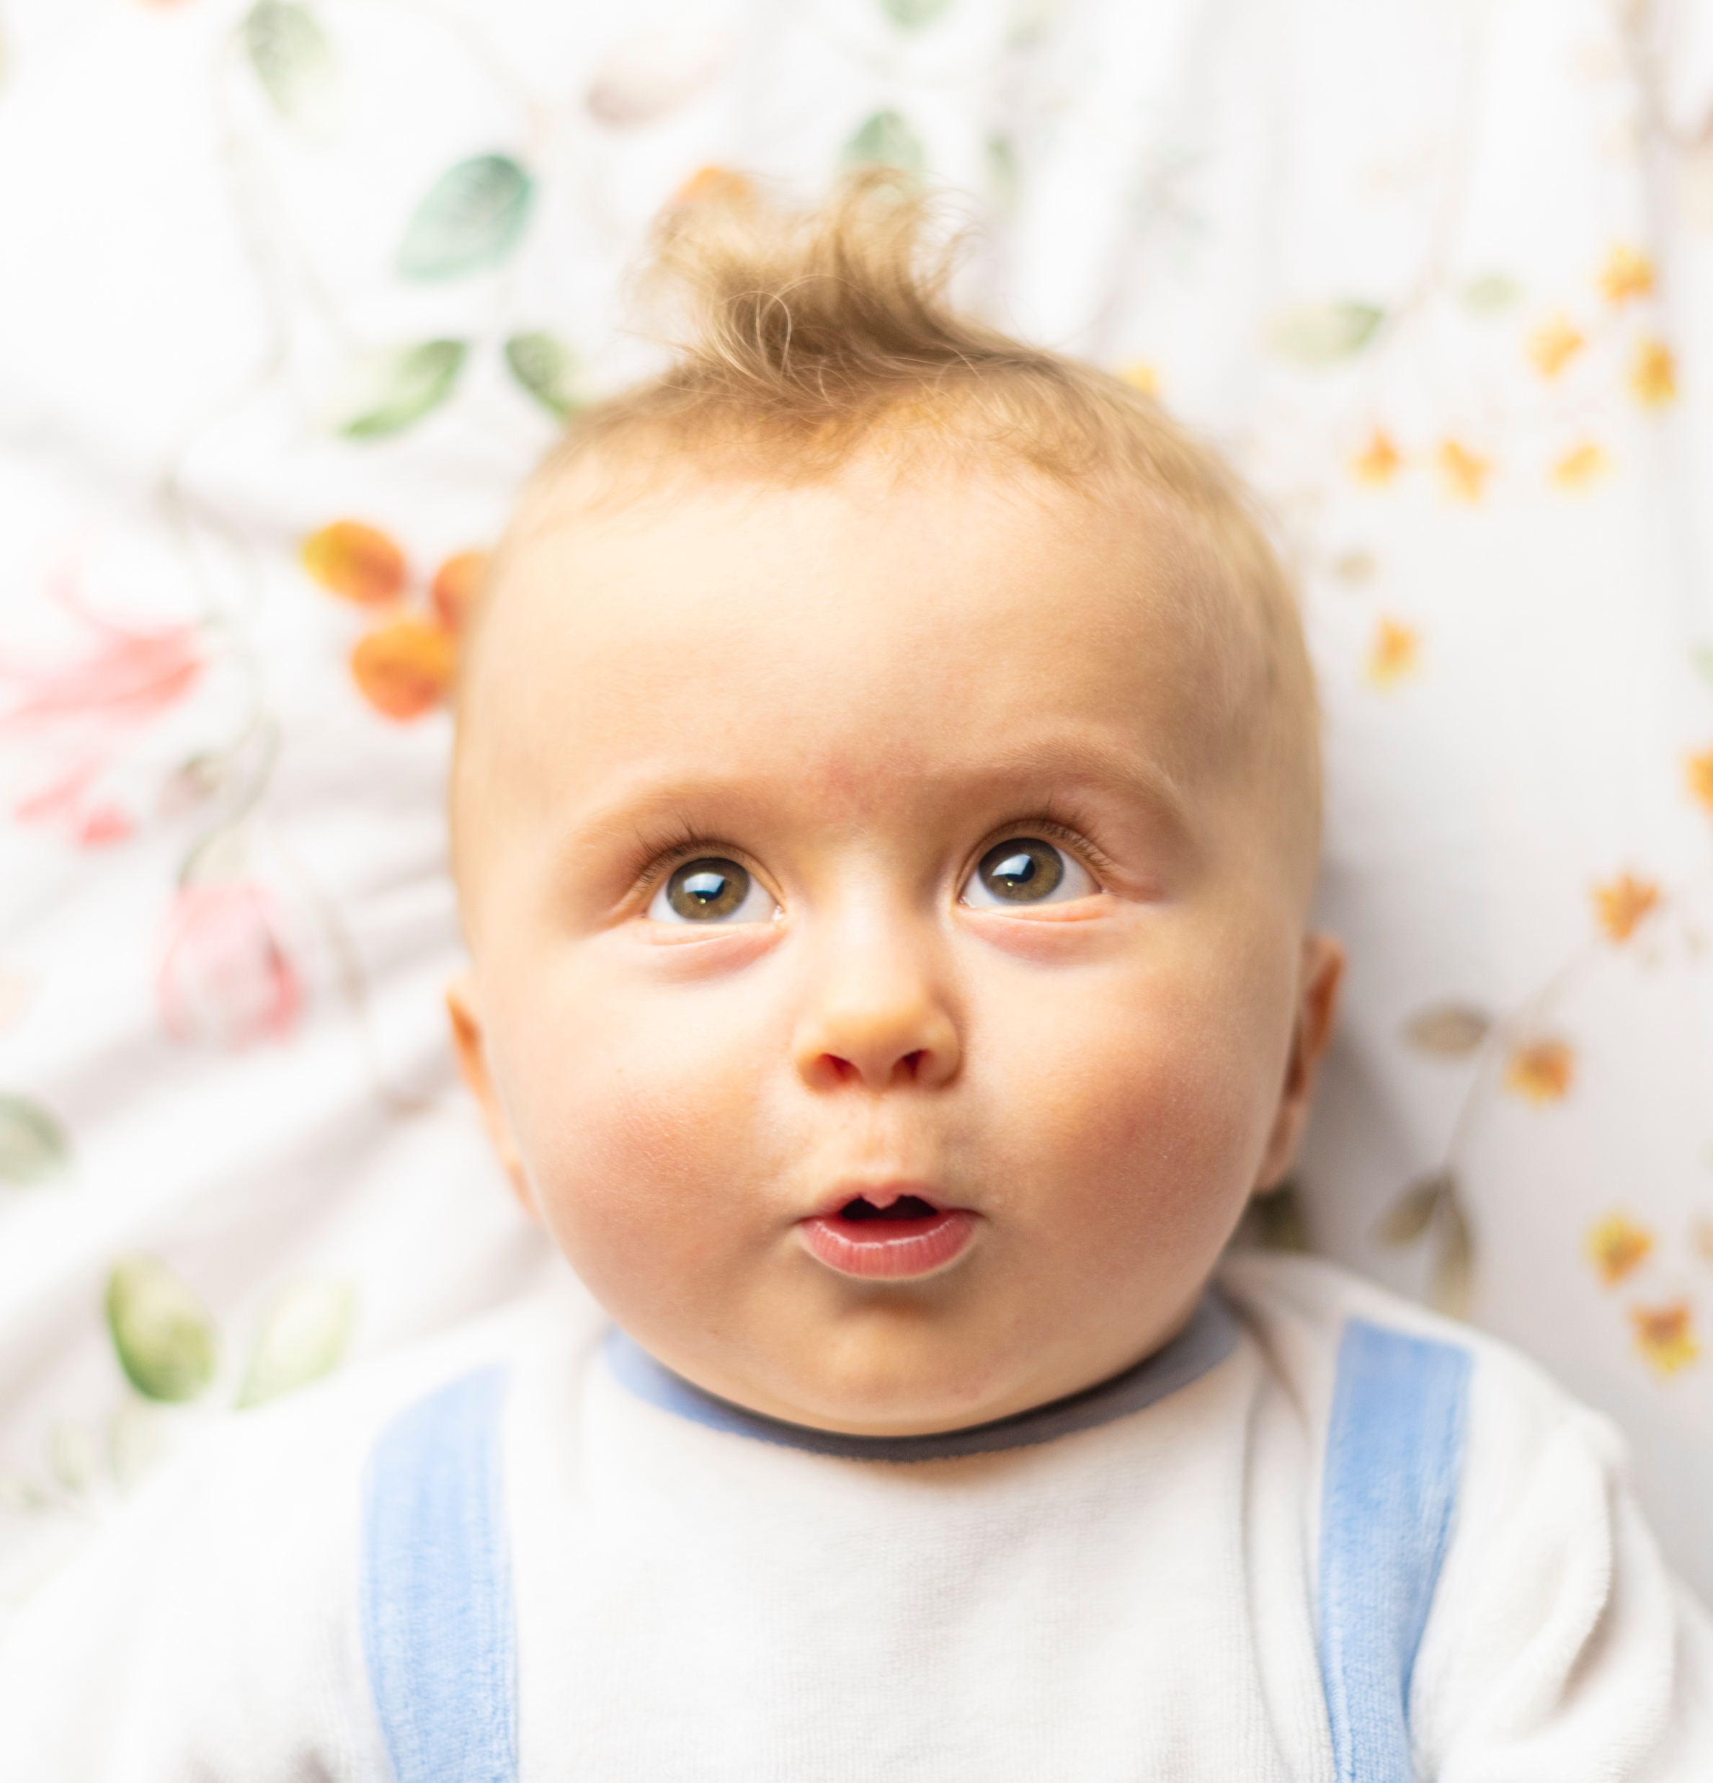
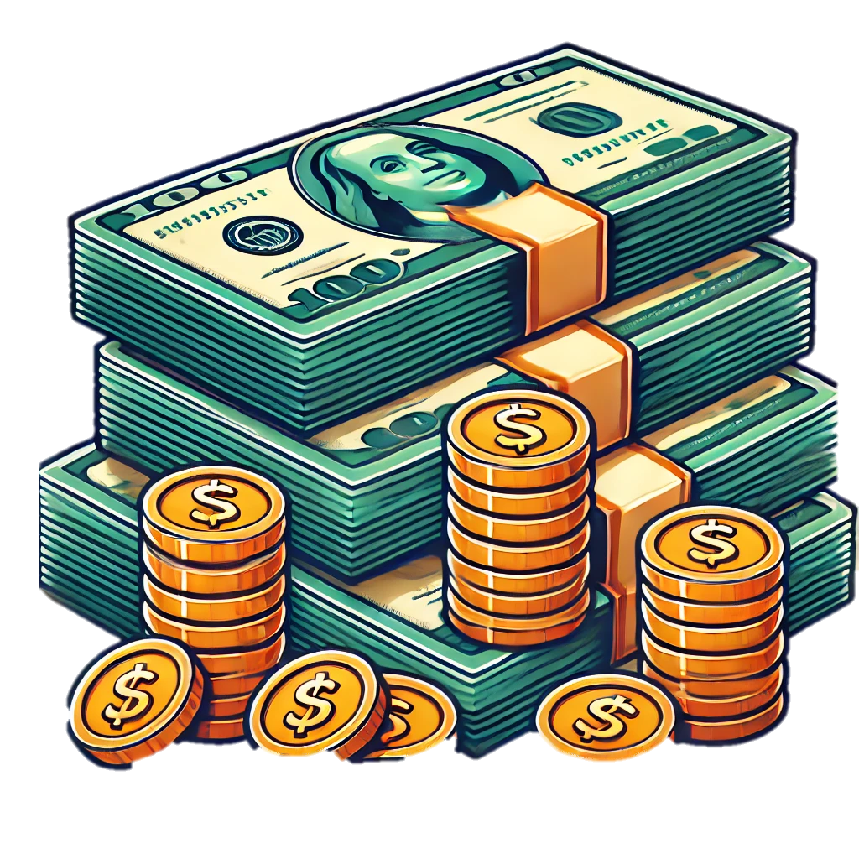
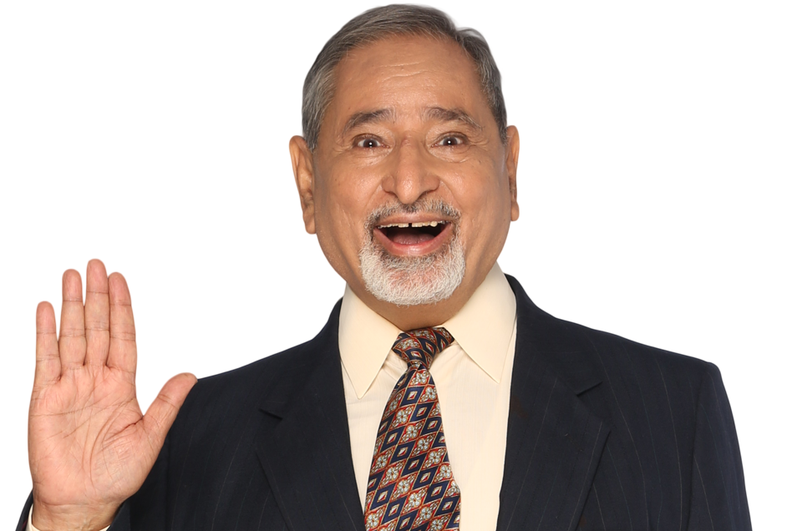




I（me）
gave
I（me）
a love letter
my brother
showed
my brother
money
my grandpa
bought
my grandpa
a lot of books
our teacher
sent
our teacher
a house
The prime minister
The prime minister
made
a textbook
（総理大臣）
（総理大臣）

