Slide 1
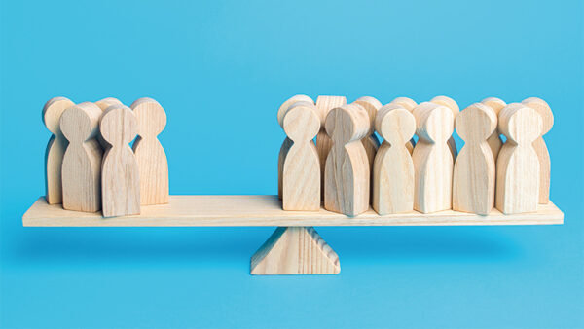
Quiz 多数派が勝ち！

Slide 2
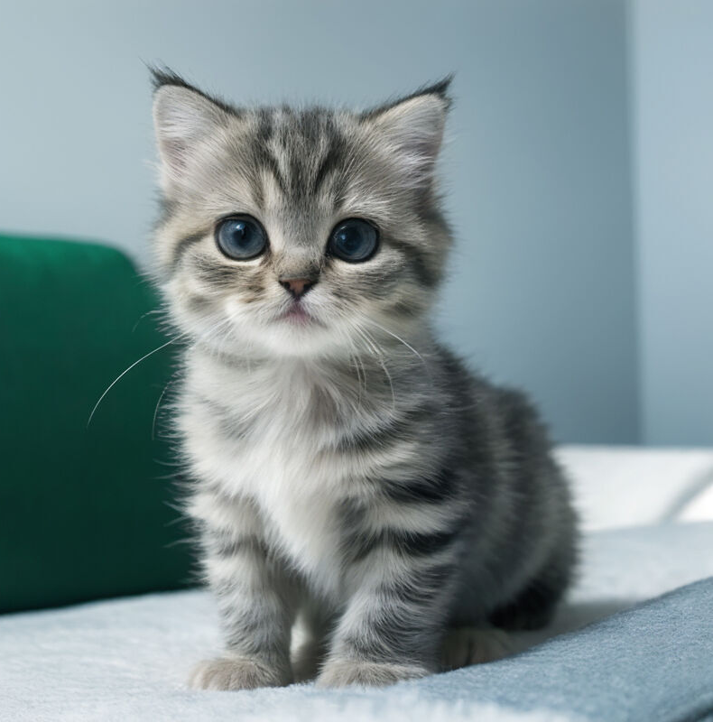
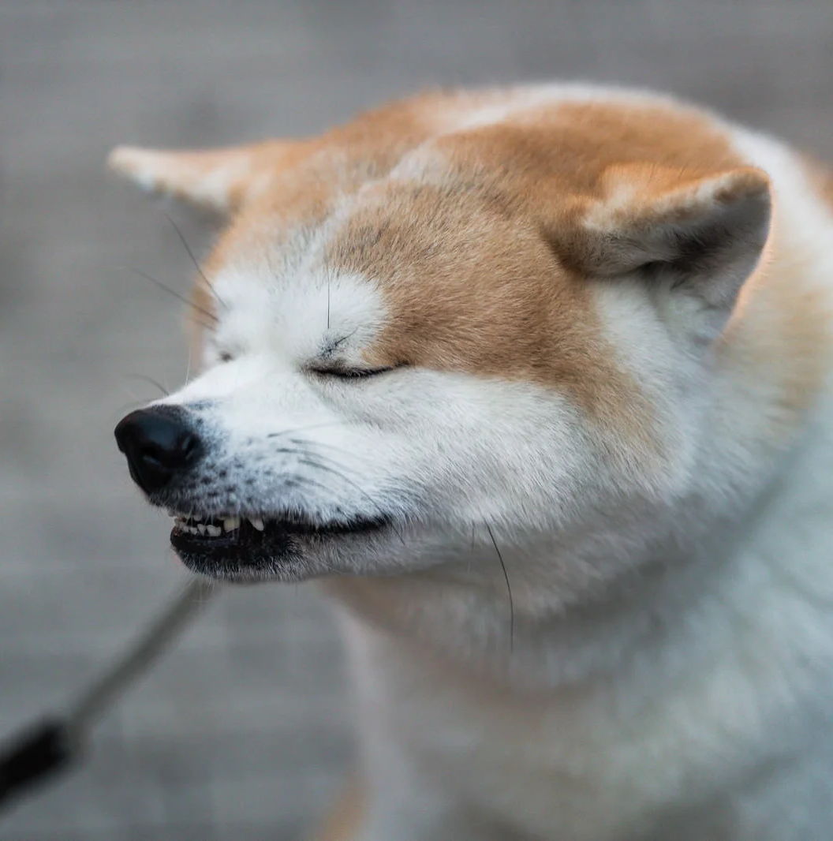
Notes:
Which is cuter, a cat or a dog?

Slide 3
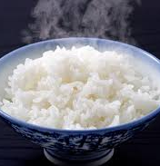
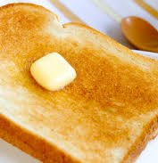
Notes:
Which do you like better for your breakfast, rice or bread?

Slide 4
お笑い芸人１
お笑い芸人２
お笑い芸人３
お笑い芸人４
Notes:
Which comedian do you like best?

Slide 5
A
B
Notes:
Which is bigger, A or B?

Slide 6
出川哲郎さん
内村光良さん
Notes:
Which is older, Mr. Degawa or Mr. Uchimura?

Slide 7
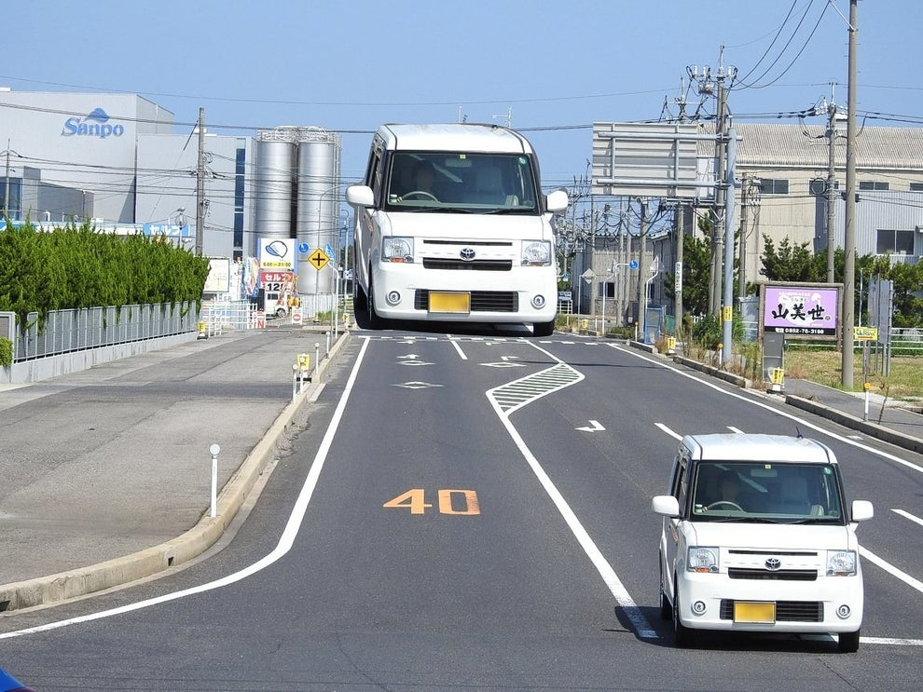
A
B
Notes:
Which is bigger, A or B?

Slide 8

A
B
Notes:
Which is bigger, A or B?

Slide 9
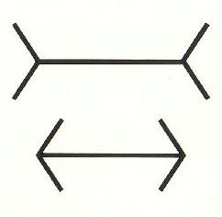
A
B
Notes:
Which is longer, A or B?

Slide 10
イケメン、美人有名人
自分（教員）
Notes:
Which is cooler, Mr.〜 or Mr.〜?

Slide 11
tall

Slide 12
as tall as

Slide 13
as tall as
同じくらい背が高い

Slide 14
A is as big as B.
A
B

